Slide 1

Industrial Computer Vision
Group 1 - Pascal Hövel (101625), Korbinian Hörmann (105766)
Final presentation 21.06.2021

Slide 2
Overview
Camera calibration (intrinsic)
Detection (Preprocessing, Segmentation (Color based, HSV), Postprocessing, Artificial environment (reproducable bounding conditions))
Classification of Lego Pieces
Multiclass Object Classification in images using CNN
Data generation
Training the model (GPU -> Google Colabs)
Deploy the model on a RaspberryPi (TensorflowLite, Transfer model format)
Multi-object tracking in videos (based on distance & features)
Final demo on video (live)
Possible improvements

Slide 3
Multiclass Object Classification on images
Using Convolutional Neural Networks (CNNs)

Slide 4
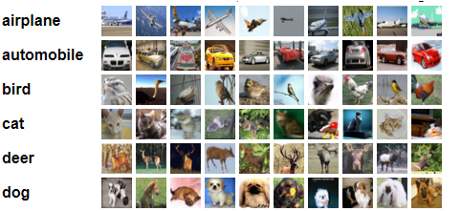
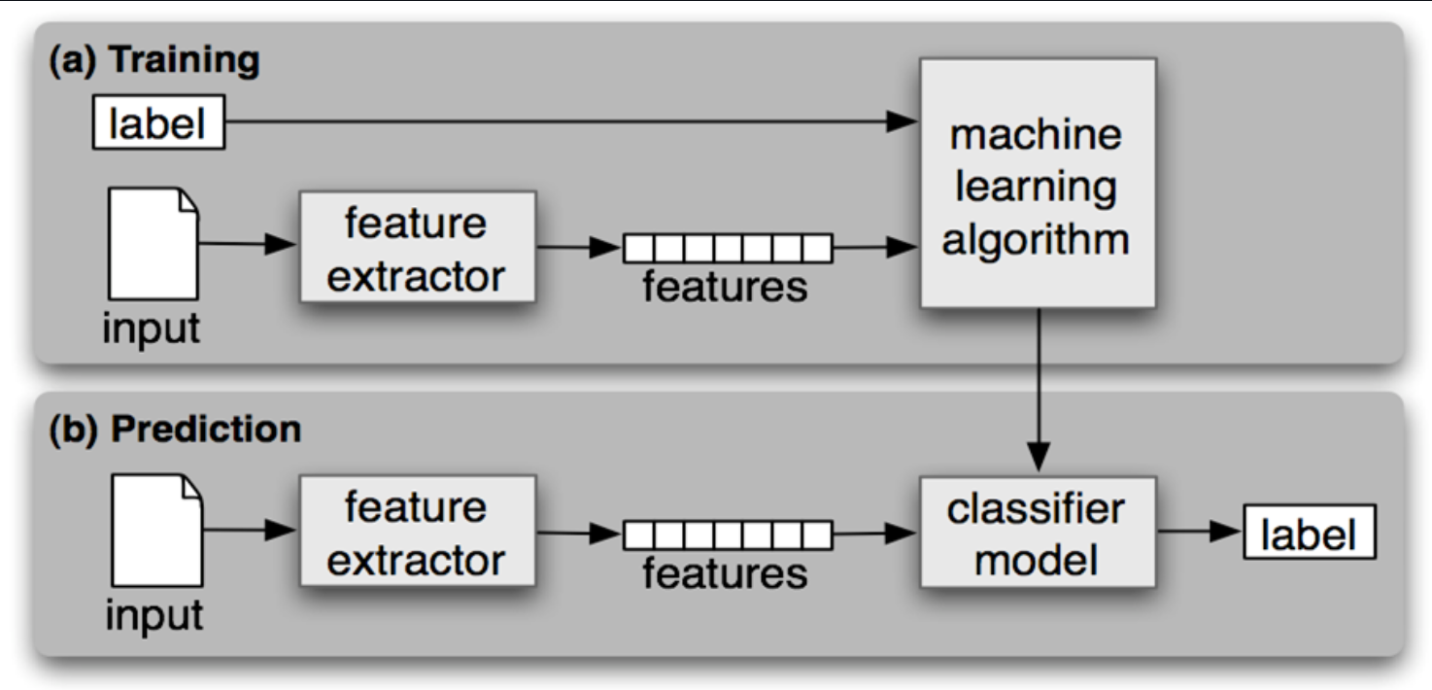
Supervised Machine Learning
Goal: find patterns in input data and map this input data to a certain class
Prerequesite: enough labeled data in order to approximate to learn a good mapping from input data to a certain class
Labled data
Training and prediction

Slide 5
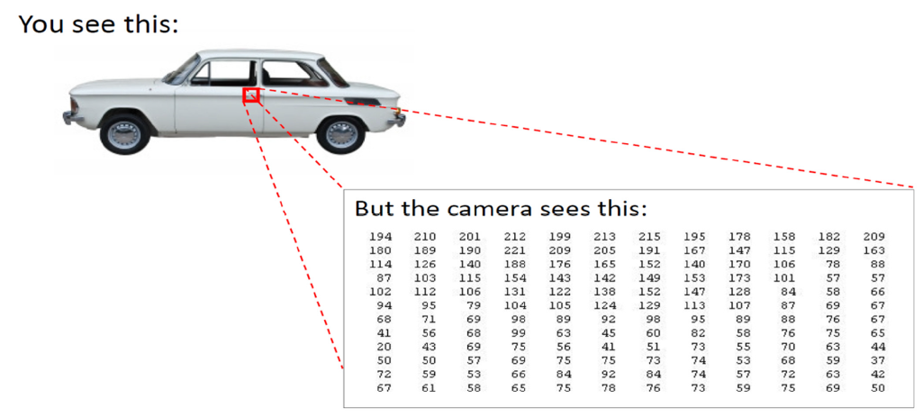
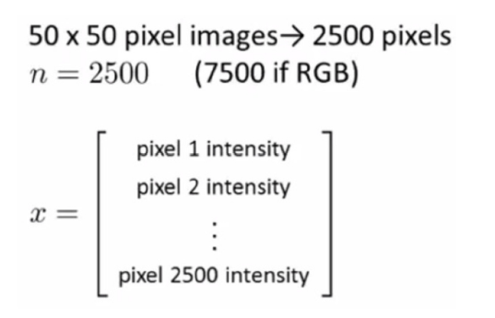
Convolutional Neural Networks - Overview
CNNs are neural networks which contain layers that extract features automatically from raw image data (latent structures not seen/difficult to be designed by humans)
Those features can then be used to solve ML tasks (e.g. classification)
Prerequisites:
needs large amounts of labelled training data
needs massive computational resources (e.g. GPUs)

Slide 6
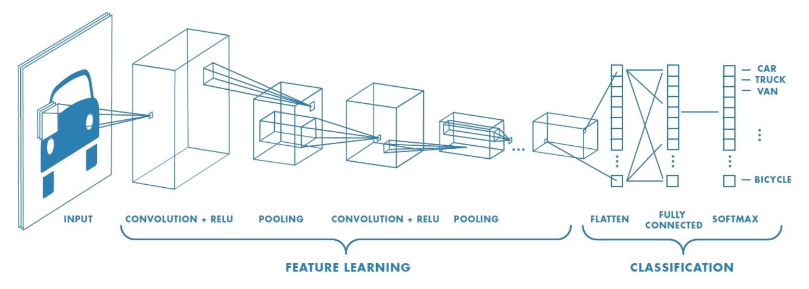
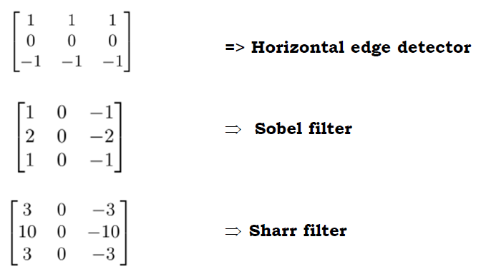
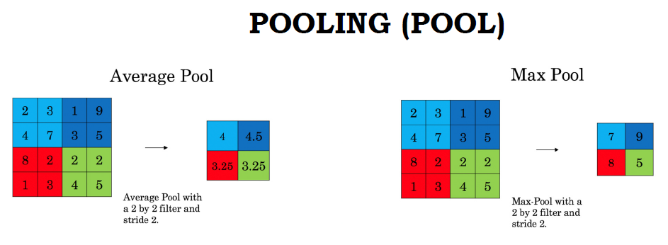
Convolutional Neural Networks - Example
Convolution (Kernels)
Pooling
e.g. to find edges
reduce input size
Preserving most important information

Slide 7
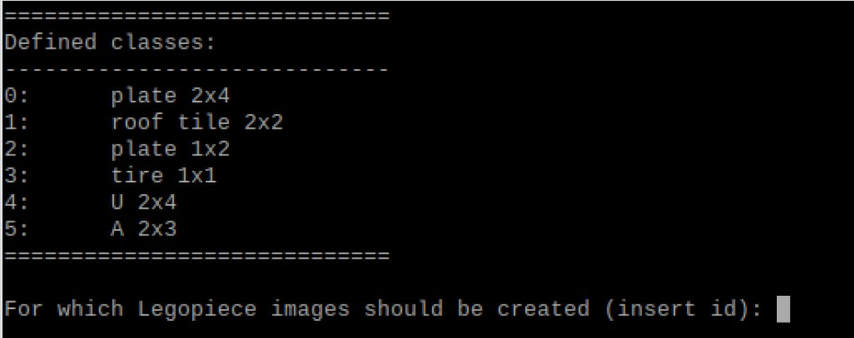
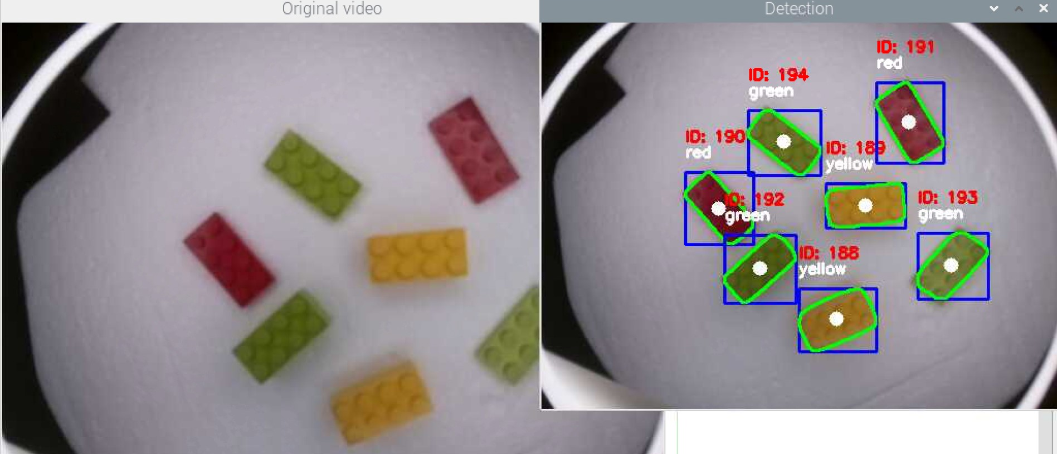
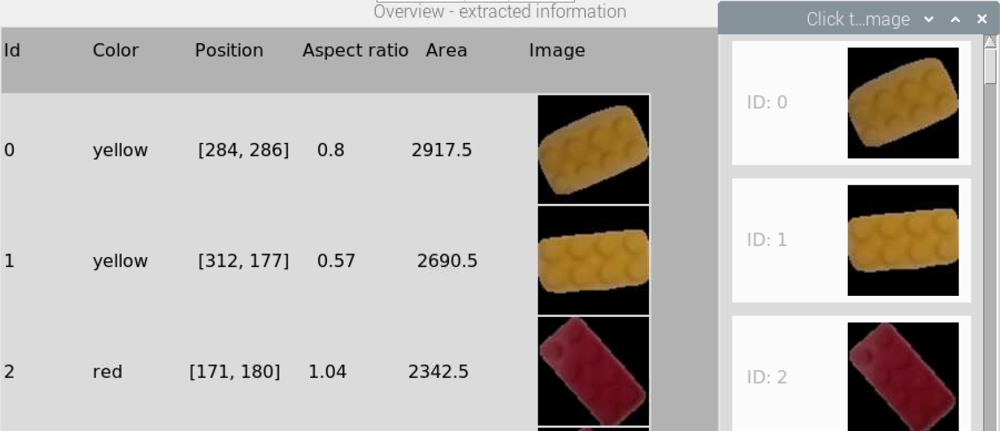
Data Generation
Goal: Build a labeled dataset of Lego pieces, on which the object classification model can be trained
Demo: image_acquisition.py

Slide 8
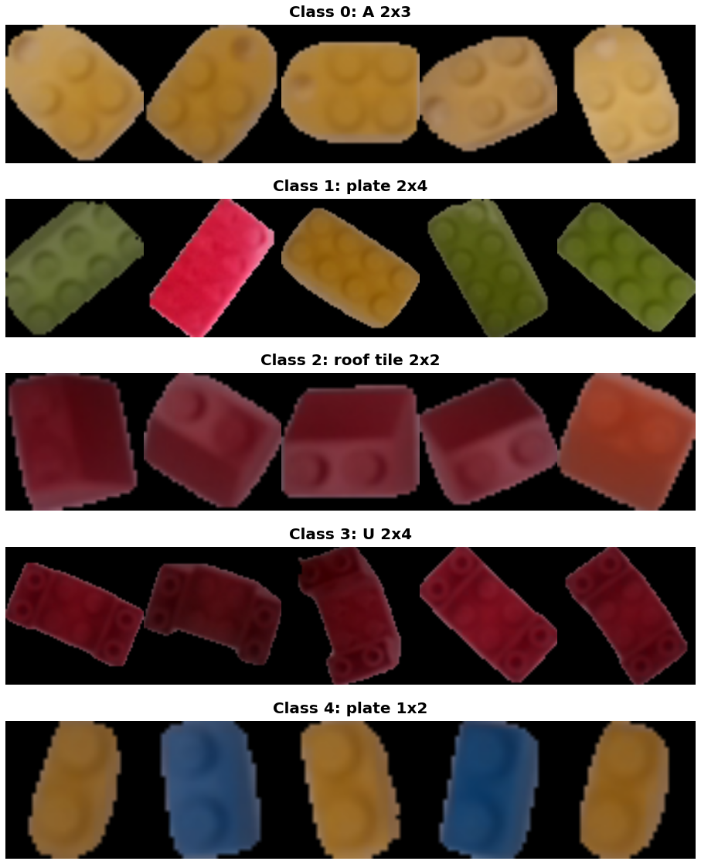
Data Generation
Final dataset: ~ 1100 images (224, 224, RGB encoded) of 5 different classes

Slide 9
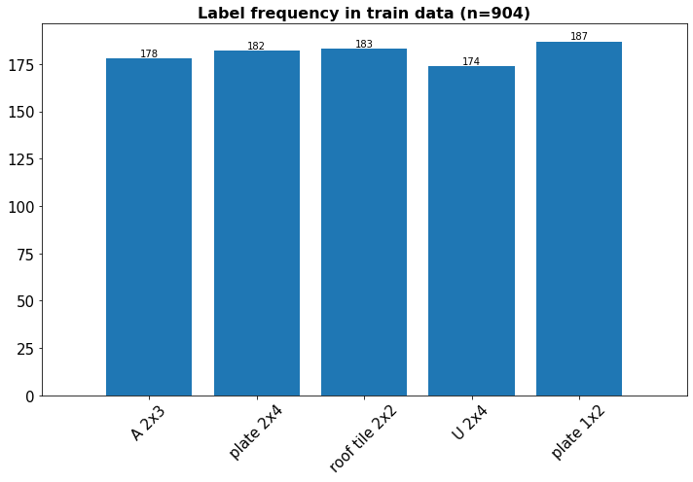
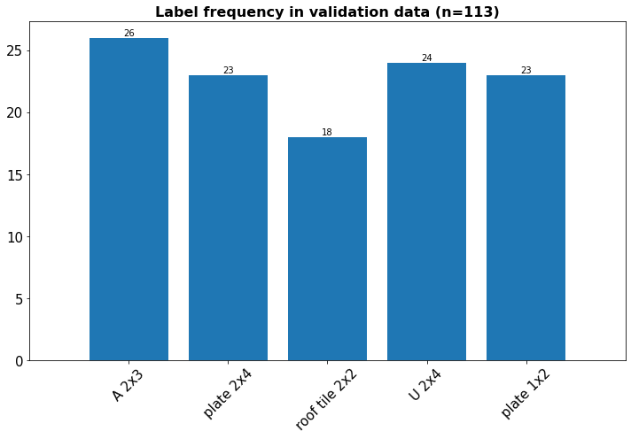
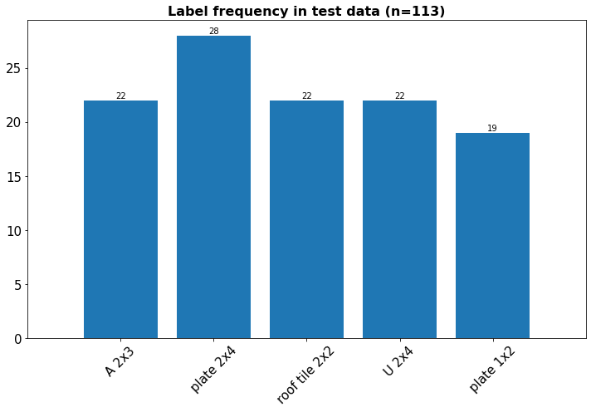
Split the data
The data is split into training, validation and test data (80, 10, 10)
The ditribution of the different labels is fairly even in each sub data set

Slide 10
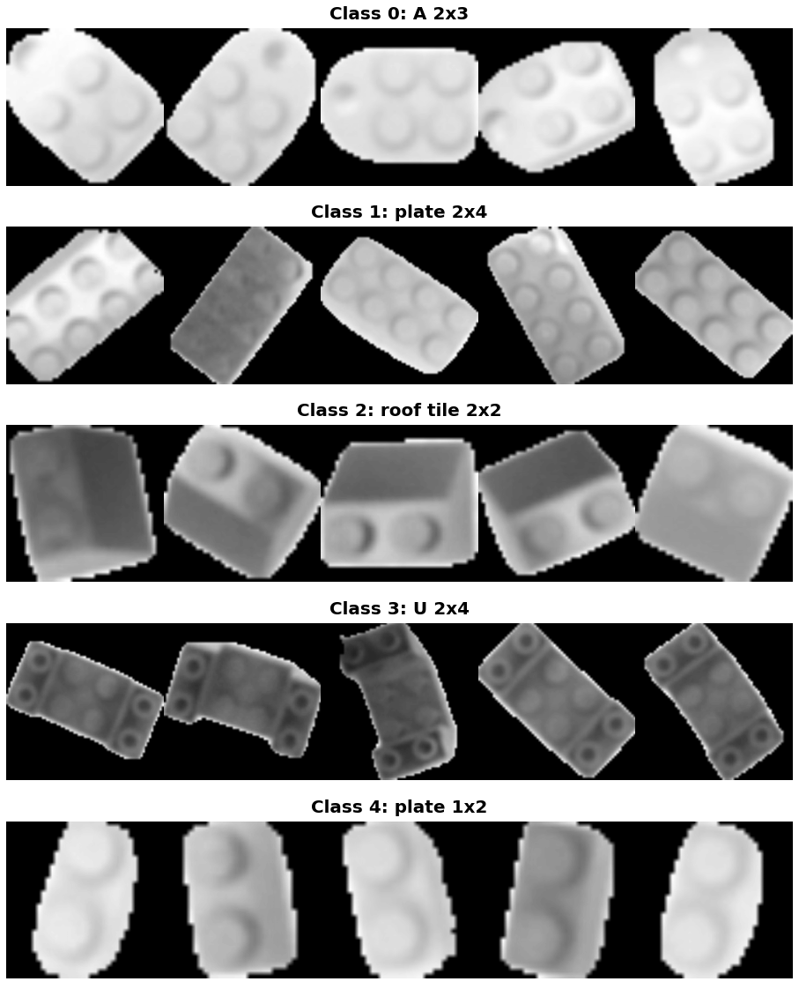
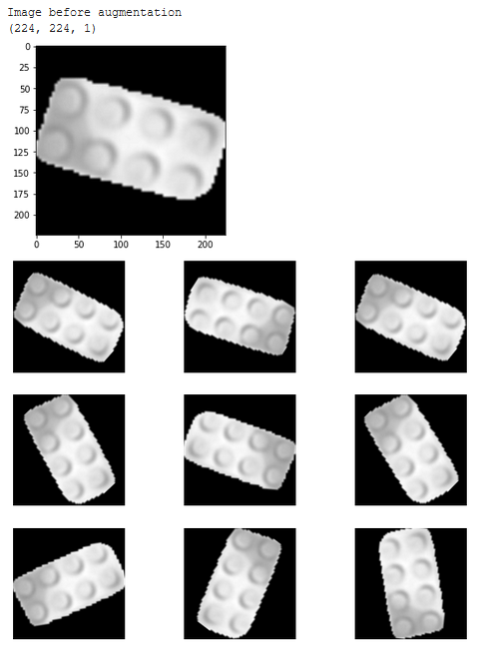
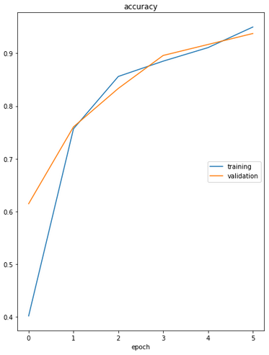
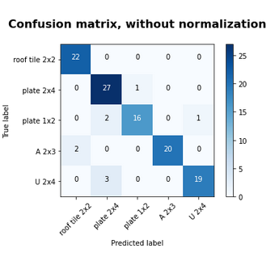
Training the model on GPU (Google Colab)
Convert dataset to grayscale images
Perform data augmentation
Train the model
Evaluate the model
Reduces input
Focus on shapes, not colors
Artificially increases the size of data and the variance of data samples
Random flip
Random contrast
Random rotation
Epochs: 6
Batch size: 32
Loss: sparse_categorical_crossentropy
Optimizer: Adam
Accuracy on test data: ~ 93%

Slide 11
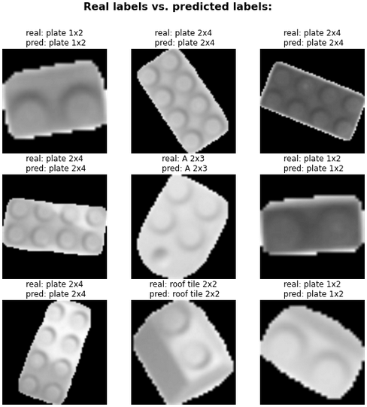
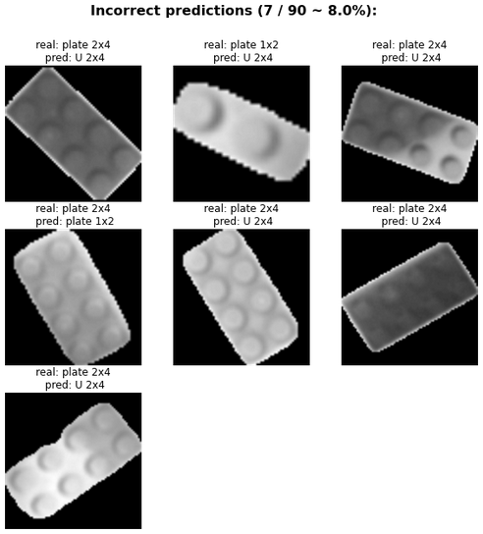
Example predictions

Slide 12
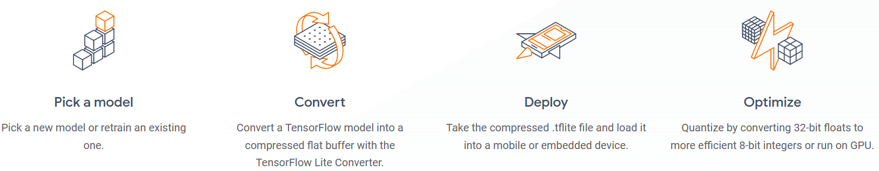
Deployment on RaspberryPi
Use of TensorFlow Lite: open source deep learning framework for on-device inference
Pipeline
Open TODO

Slide 13
Multi object tracking in videos
Distance based approach:
detected_pieces = {}
for each new frame
segment image -> detect Lego pieces
for each detected Lego piece:
if position not in already in detected pieces + threshold
generated UID, predict class & extract other features
add new piece to detected_pieces
else
update position of already existing Lego
Pseudo code

Slide 14
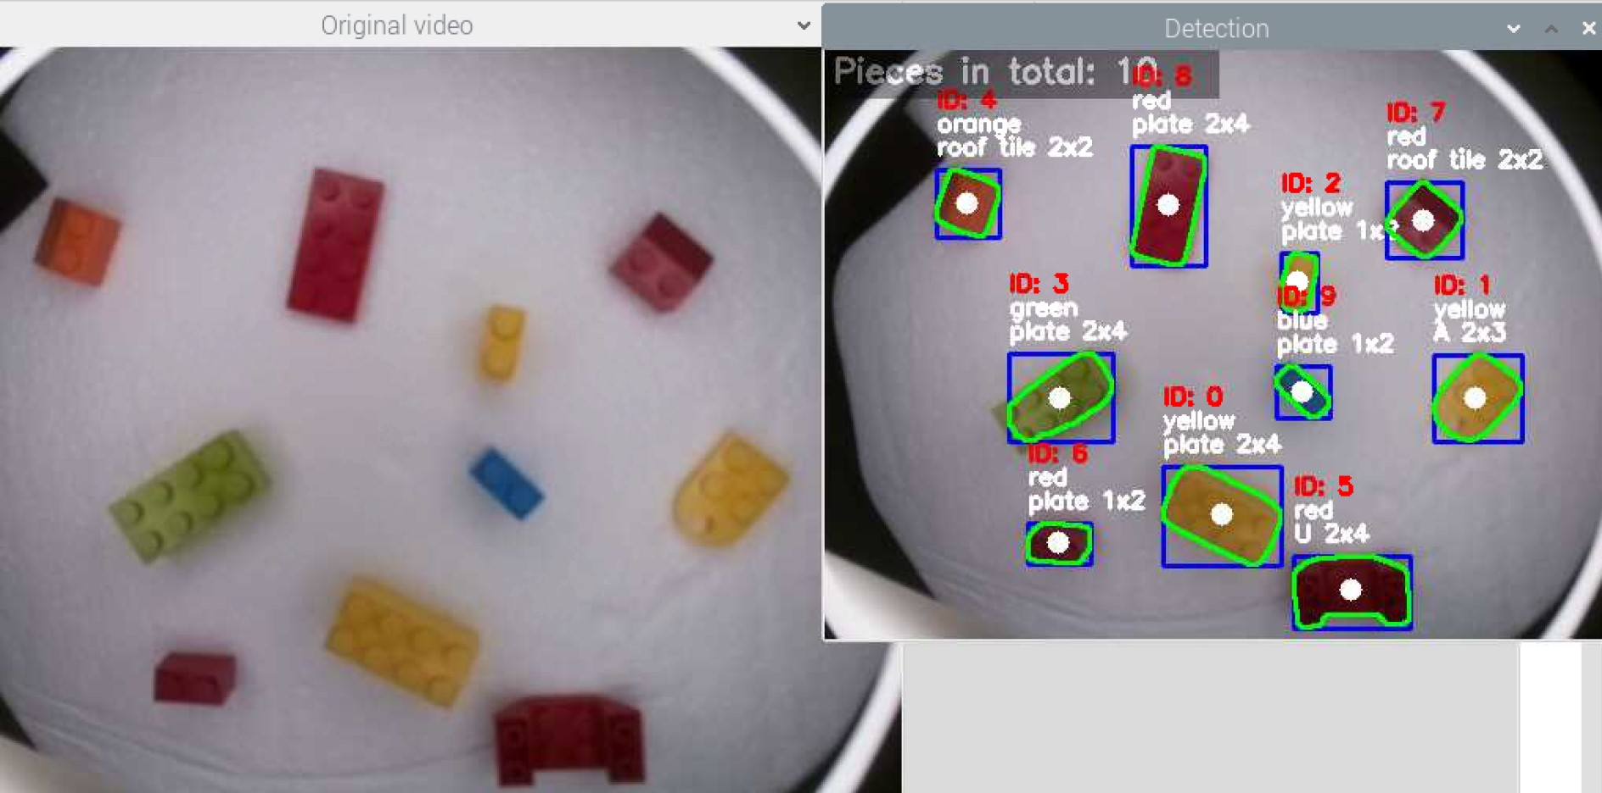
Live demo – video stream
The script lego_brick_detection.py detects Lego pieces in the video stream and uses a tflite model which was trained on Google Colab to predict the class of the lego pieces.
Each piece gets it’s unique id and is tracked over time.

Slide 15
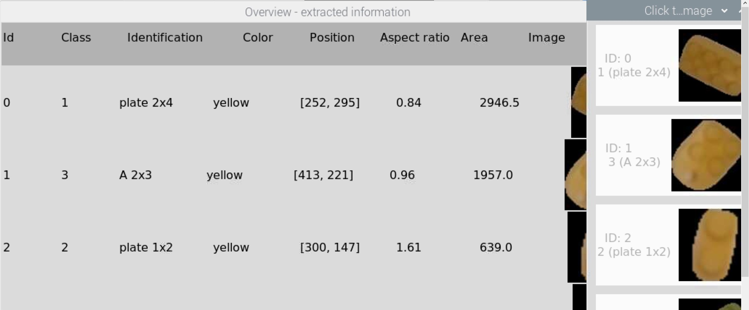
Live demo – final overview
After hitting 'ESC', two windows are shown.
Overview: contains information about all the detected pieces, the second one only shows the Id, extracted image, predicted class of this piece.
Possibility to save image: in case this predicted id is correct, those columns can be clicked and the images are saved to the 'dataset/' folder in order to increase the size of the dataset with which the model can be trained.

Slide 16
Possible improvements
Prediction model
Data
Object Tracking
Build smaller model
Add more training data of pieces where the prediction model makes mistakes
Implement a more comlicated solution for object tracking
Quantize the .tflite model
Improve image quality
Try out different architecture
(e.g. YOLO)

